Slide 1
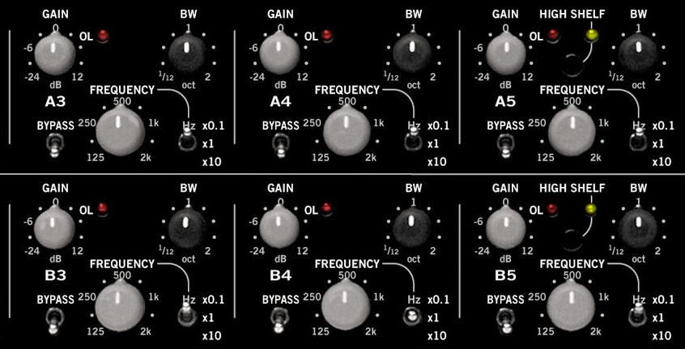
Parametric EQ

Slide 2
Introduction
Parametric equalisers
Digital filters used in audio for adjusting frequency content of a sound signal
Graphic EQs only allow gain adjustment for each band
Parametric EQs allow gain, centre frequency, and bandwidth adjustment of each filter
Design 1: 2nd-order IIR filters
Simplest design allowing specification of all parameters
Relatively large transition regions
May overlap when several are connected in cascade
Design 2: Higher-order IIR filters
More control over shape of filter
Sharper transition regions possible
Notes:
Parametric equalisers are digital filters used in audio for adjusting the frequency content of a sound signal. Parametric equalisers provide capabilities beyond those of graphic equalisers by allowing the adjustment of gain, center frequency, and bandwidth of each filter. In contrast, graphic equalisers only allow for the adjustemnt of the gain of each filter.
Typically, parametric equalisers are designed as second-order IIR filters. These filters have the drawback that because of their low order, they can present relatively large transition regions and may overlap with each other when several of them are connected in cascade. High-order IIR parametric equalisers provide much more control over the shape of each filter. In addition, the designs special case to traditional second-order parametric equalisers if the order of the filter is set to two.

Slide 3
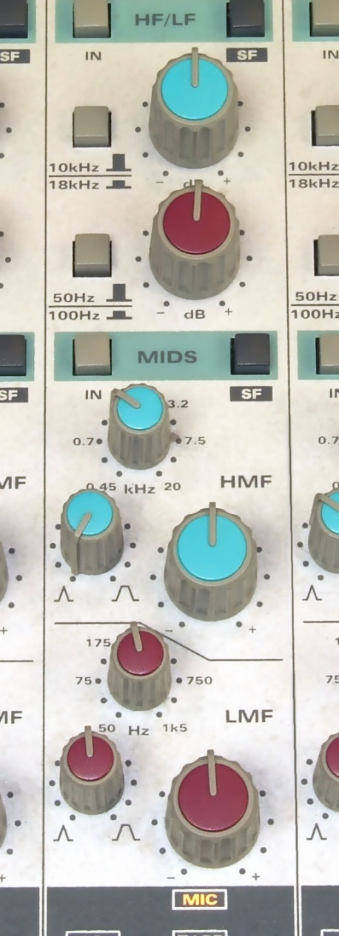
Parametric EQ basics
Flexible, but requires care
Allows control over
Boost or cut amount
Centre frequency
Bandwidth or Q
Components of parametric equalisers
Shelving filters
Peaking filters
Equaliser section from Audient ASP8024 Mixing console. Upper section has high & low shelving EQ, lower section has fully parametric EQ.
Notes:
The parametric equaliser is the ultimate as far as flexibility goes, but they require a little more care to use effectively. A single parametric EQ allows you to set not only the amount of boost or cut, but also the center frequency and the bandwidth. With experience, you can learn where to apply some boost to help an instrument cut through the mix or achieve a fuller sound. For feedback cancellation, a parametric EQ with a lot of cut (also called a notch filter) can be positioned right at the frequency where the feedback is occurring. To minimize the filter's effect on the rest of the sound, you can use a small bandwidth. You might be able to control the feedback with a graphic EQ as well, but if its bands are quite wide, you will be cutting more of the sounds that you do want to be heard. A similar application would be removing the 60 Hz hum in a recording (but you have to notch out the harmonics as well). The shelving and peaking filters are essentially specific types of parametric equalisers, at least mathematically, but most commercial products do have limits on parameters available.

Slide 4
Why parametric EQ?
Apply cut for
Feedback cancellation
Put a notch at feedback frequency
Can do this with graphic EQ, but less precise
Small bandwidth to avoid affecting other sounds
Line noise / hum removal
Apply a cut at 50Hz or 60Hz
Also at harmonics
Apply a boost to
Help instrument cut through mix
Achieve fuller sound
Use small bandwidth to minimise effect on rest of sound
Notes:
For feedback cancellation, a parametric EQ with a lot of cut (also called a notch filter) can be positioned right at the frequency where the feedback is occurring. To minimize the filter's effect on the rest of the sound, you can use a small bandwidth. You might be able to control the feedback with a graphic EQ as well, but if its bands are quite wide, you will be cutting more of the sounds that you do want to be heard. A similar application would be removing the 60 Hz hum in a recording (but you have to notch out the harmonics as well). The shelving and peaking filters are essentially specific types of parametric equalisers, at least mathematically, but most commercial products do have limits on parameters available.

Slide 5
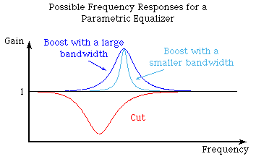
Parametric EQ plots
Parametric EQ is combination of low shelf, peaking/notch filters, and high shelving filter
Peaking/notch filter
Controls: centre frequency, gain, bandwidth
Low and high shelving filter
Controls: cuttoff frequency, gain
Typically not bandwidth

Slide 6
Magnitude response of shelving filters
varying gain (left) varying center frequency (right)
Boost
Cut
low shelving filter (top)
high shelving filter (bottom)
Boost
Cut

Slide 7
Magnitude responses for peaking or notch filter
vary gain
vary center frequency
Boost
Cut
vary bandwidth

Slide 8
Building a complete equaliser
Combination of peaking and shelving filters can be used
One low shelf, one high shelf, many peaking / notch filters
Connect in series (cascade)
x[n]
…
y[n]
Low shelf
Peaking/ notch
Peaking/ notch
High shelf

Slide 9
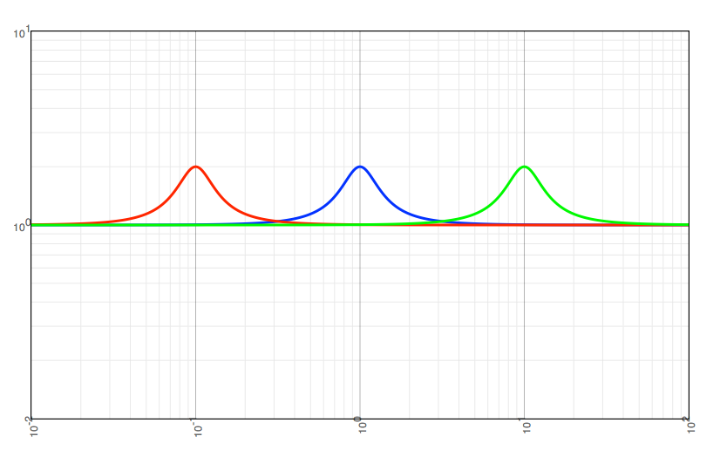
Q factor
Quality factor: ratio of centre frequency and bandwidth
Q=ω_{c}/B
Constant Q peak filters
Tune centre frequency while keeping Q constant
Bandwidth scales with frequency
log-frequency scale
Notes:
One often used filter is the constant Q peak filter.
Q factor is defined as the bandwidth relative to cut-off frequency.
Q=ω_{c}/B
The cut-off frequency of peak filters is then tuned while keeping Q constant. So the bandwidth is increased when cut-off frequency increased and vice versa.

Slide 10
Parametric Equaliser samples
http://sonicflow.sourceforge.net/sounds/
Original
Example 1
low band corner frequency 300Hz, gain -20dB
mid band center frequency 800Hz, width 300Hz, gain +10dB
high band corner frequency 5000Hz, gain -20dB
Example 2
low band corner frequency 100Hz, +10dB
mid band center frequency 400Hz, width 200Hz, gain -20dB
high band corner frequency 5000Hz, gain -20dB
Example 3
low band corner frequency 200Hz, -20 dB
mid band center frequency 400Hz, width 100Hz, gain +20dB
high band corner frequency 10000Hz, gain +20dB

Slide 11

Sound examples
From http://sonicflow.sourceforge.net/sounds/
Original
Example 1
Low band corner frequency 300Hz, gain -20dB
Mid band centre frequency 800Hz, width 300Hz, gain +10dB
High band corner frequency 5000Hz, gain -20dB
Example 2
Low band corner frequency 100Hz, +10dB
Mid band centre frequency 400Hz, width 200Hz, gain -20dB
High band corner frequency 5000Hz, gain -20dB
Example 3
Low band corner frequency 200Hz, -20 dB
Mid band center frequency 400Hz, width 100Hz, gain +20dB
High band corner frequency 10000Hz, gain +20dB

Slide 12
Demo

Slide 13

Parametric filter design
Design of 2nd-order parametric equaliser
Constraints
Solution
MATHS

Slide 14
Second Order IIR Design
Find transfer function specifying;
centre frequency ω_{c}
gain at centre frequency G
bandwidth B or Q-factor Q = ω_{c}/B
Constraints
Gain max. at centre frequency:
Magnitude at centre frequency:
Bandwidth:
Additional constraints
Gain at DC
Gain at Nyquist

Slide 15
DC & Nyquist constraints
Biquad filter
From Nyquist and DC constraints
So
Square magnitude becomes

Slide 16
Centre frequency & gain constraints
Centre frequency constraint rewritten as
So from
Gain at centre frequency constraint written as
Which is inverted to give

Slide 17
Bandwidth constraint
Square magnitude becomes
The bandwidth constraint is
At upper and lower cut-off frequencies
so

Slide 18
Bandwidth constraint
Lets define bandwidth as arithmetic mean of extremes of square magnitude response
G_{B}²=(1+G²)/2
So
And hence
We define
For both upper and lower frequencies

Slide 19
Second Order IIR Design
Consider
The ω_{c} term can be eliminated to give
Using trigonometric product formulas
→

Slide 20
Putting it all together

Slide 21
Some basic designs
Consider two parametric EQ designs:
2nd and 4th order in MATLAB Signal Processing Toolbox
Design 1
2nd order design with 6dB boost at 0.5π rad/sample
Design 2
4th order design with 6dB boost at 0.5π rad/sample
F0: 0.5, BW: 0.2, Reference gain: 0dB
Centre frequency gain: 6dB
Gain where BW measured: 6 + 10log10(0.5) ~= 3dB
f = fdesign.parameq('N,F0,BW,Gref,G0,GBW',2,.5,.2,0,6,6+10*log10(.5));
h2order = design(f);
f.FilterOrder = 4;
h4order = design(f);
hfvt = fvtool(h2order, h4order ,'Color','white');
legend(hfvt,'2nd-Order Design','4th-Order Design');
Notes:
Some Basic Designs
Consider the following two designs of parametric equalisers. The design specifications are the same except for the filter order. The first design is a typical second-order parametric equaliser that boosts the signal around 0.5*pi rad/sample by 6 dB. The second design does the same with a fourth-order filter. Notice how the fourth-order filter resembles an ideal brickwall filter closer than the second-order filter. Obviously the approximation can be improved by increasing the filter order even further. The price to pay for such improved approximation is increased implementation cost as more multipliers are required.

Slide 22
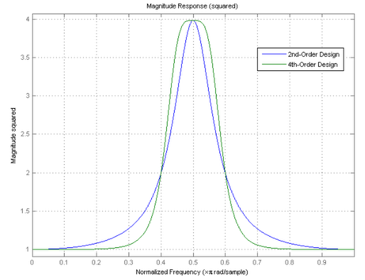
Some basic designs
Notice sharper transition for 4th-order
Notes:
Some Basic Designs
One of the design parameters is the filter bandwidth, BW. You not only specify what the desired bandwidth is, you also specify at what gain this bandwidth is specified, GBW. In this case, we set GBW to be at half the peak magnitude squared gain of the filter, that is, approximately 3.0103 dB below the 6 dB gain. To see this, we can plot the magnitude squared and verify that the point at which the filter's bandwidth is 0.2*pi as specified is half of the peak magnitude squared.

Slide 23
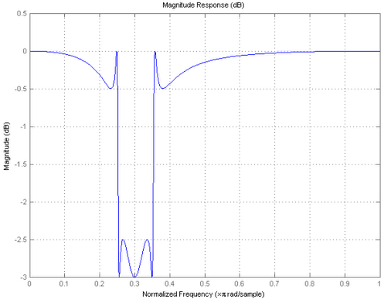
Parametric EQ that cuts
Previous design boosts signal over a given frequency band
Can also design EQs that attenuate (cut) a given band
f=fdesign.parameq(‘N,F0,BW,Gref,G0,GBW,Gp,Gst’,6,.3,.1,0,-3,-2,-2.5,-0.5);
Specified passband and stopband gains
Allow ripple but achieve steeper transition
Notes:
The previous design is an example of a parametric equaliser that boosts the signal over a certain frequency band. You can also design equalisers that cut (attenuate) the signal in a given region.
setspecs(f,'N,F0,BW,Gref,G0,GBW,Gp,Gst',6,0.3,0.1,0,-3,-2,-2.5,-0.5);
h = design(f);
set(hfvt,'Filters',h,'MagnitudeDisplay','Magnitude (dB)','legend','off');
axis([0 1 -3 0.5])
Notice that in this case we have specified both a passband gain, Gp, and a stopband gain, Gst. This parameters allow for the filter to ripple in the passband and stopband with the advantage of providing steeper transitions between passband and stopband. For comparison, consider a filter of the same order without ripples. Notice the wider transitions that result as a tradeoff.

Slide 24
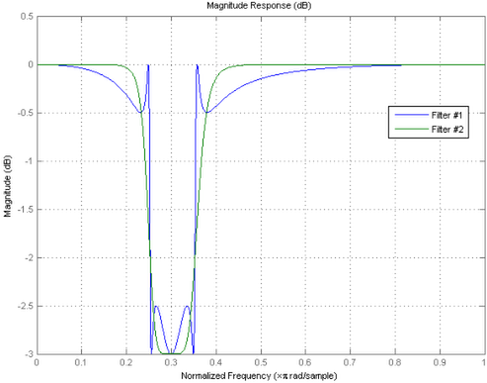
Parametric EQ that cuts
The same thing without ripple...
f=fdesign.parameq('N,F0,BW,Gref,G0,GBW',6,0.3,0.1,0,-3,-2);
Wider transition region as tradeoff
Notes:
Notice that in this case we have specified both a passband gain, Gp, and a stopband gain, Gst. This parameters allow for the filter to ripple in the passband and stopband with the advantage of providing steeper transitions between passband and stopband. For comparison, consider a filter of the same order without ripples. Notice the wider transitions that result as a tradeoff.
It is also possible to only specify ripples in the passband or to only specify ripples in the stopband.

Slide 25
Minimum-order designs
Previous examples started with filter order
This time, set specifications and figure out minimum order that will meet them
In addition to bandwidth BW and gain GBW:
Passband width BWp and minimum passband gain Gp
Butterworth filters give maximally flat response
Chebyshev Type I allows passband ripples
Other types: Chebyshev Type II allows stopband ripples, Elliptical allows both passband and stopband ripples
f = fdesign.parameq('F0,BW,BWp,Gref,G0,GBW,Gp‘, .5,.2,.18,0,6,6+10*log10(.5),5.8); h = design(f,'butter');h1 = design(f,'cheby1');
Notes:
Returning to the first design, instead of manually increasing the filter order to better approximate a brickwall filter, we can specify the desired shape and design a filter of minimum-order that meets such specifications. To specify the shape, in addition to the bandwidth BW and corresponding gain GBW, we specify a passband bandwidth BWp and corresponding gain Gp. It would also be possible to specify a stopband bandwidth and corresponding gain.
Notice that we specified that we wanted a Butterworth (i.e. a maximally flat) design. If we allow for passband ripples, we can design a Chebyshev Type I filter instead

Slide 26
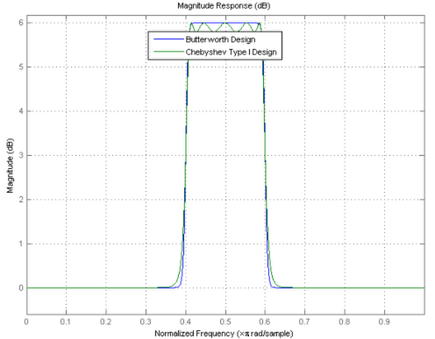
Minimum-order designs
Tradeoff between ripple and filter order:
Butterworth: N = 32
Chebyshev: N = 10
Notes:
In this case, the tradeoff occurs between ripples and filter order.
bord = order(h) % Order of Butterworth design
cord = order(h1) % Order of Chebyshev Type I design
------------
bord = 32
cord = 10

Slide 27
Lowpass/highpass shelving filters
In discrete time...
Filter bandwidth only perfectly symmetrical about centre frequency when F0=0.5π (half Nyquist rate)
When F0 closer to 0 or π, warping makes larger portion of bandwidth occur to one side of F0
When F0 = 0, entire bandwidth occurs to right of F0
This is lowpass shelving filter
When F0 = π, entire bandwidth occurs to left of F0
This is highpass shelving filter
f=fdesign.parameq('F0,BW,BWp,Gref,G0,GBW,Gp,Gst‘,
0, .3, 0.2, 0, 4, 2, 3.5, 0.5); f1=fdesign.parameq('F0,BW,BWp,Gref,G0,GBW,Gp,Gst‘,
1, .3, 0.2, 0, 4, 2, 3.5, 0.5); h = design(f); h1 = design(f1); set(hfvt,'Filters',[h h1]); legend(hfvt,'Lowpass Shelving Filter','Highpass Shelving Filter');
Notes:
The filter's bandwidth BW is only perfectly centered around the center frequency F0 when such frequency is set to 0.5*pi (half the Nyquist rate). When F0 is closer to 0 or to pi, there is a warping effect that makes a larger portion of the bandwidth to occur at one side of the center frequency. In the edge cases, if the center frequency is set to 0 (pi), the entire bandwidth of the filter occurs to the right (left) of the center frequency. The result is a so-called shelving lowpass (highpass) filter.

Slide 28
Lowpass/highpass shelving filters
Warping makes it hard to control exact frequency edges where bandwidth occurs
In discrete time...
Filter bandwidth only perfectly symmetrical about centre frequency when ω_{c}=0.5π (half Nyquist rate)
When ω_{c} closer to 0 or π, warping makes larger portion of bandwidth occur to one side of ω_{c}
When ω_{c} = 0, entire bandwidth occurs to right of ω_{c}
This is low shelving filter
When ω_{c} = π, entire bandwidth occurs to left of ω_{c}
This is high shelving filter

Slide 29
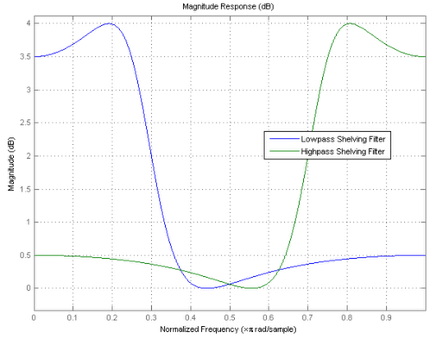
Lowpass/highpass shelving filters

Slide 30
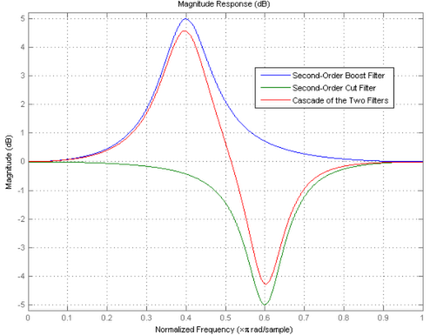
Cascading Parametric Equalisers
Parametric equalisers usually connected in series
f1 = fdesign.parameq('N,F₀,BW,G_{ref},G₀,G_{BW}',2,.4,.2 ,0, 5, 5+10log₁₀(.5));
f2 = fdesign.parameq('N,F₀,BW,G_{ref},G₀,G_{BW}',2,.6,.15,0,-5,-5-10log₁₀(.5));
h1 = design(f1);
h2 = design(f2);
hc = cascade(h1,h2);

Slide 31
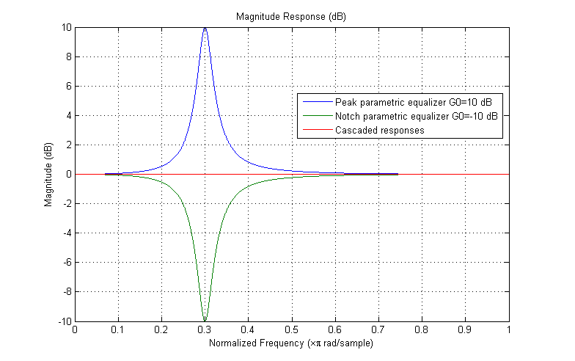
Complementary Peak and Notch Parametric Equalizers
A boost and a cut of equal amounts should cancel out their effect on the magnitude response
From Matlab Parametric Equalizer design, http://www.mathworks.co.uk/help/dsp/examples/parametric-equalizer-design.html

Slide 32
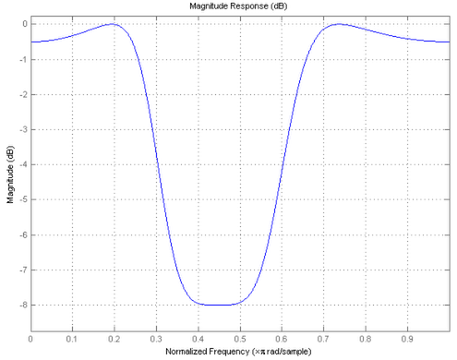
Specifying low frequencies
Warping makes it hard to control exact frequency edges where bandwidth occurs
Instead, use an alternate specification
Here, gain specified at -7dB at 0.35π and 0.55π
f = fdesign.parameq('N,Flow,Fhigh,Gref,G0,GBW,Gst‘,
4,.35,.55,0,-8,-7,-0.5); h = design(f);
Notes:
Because of the frequency warping mentioned, in general it can be difficult to control the exact frequencies edges at which the bandwidth occurs. To do so, an alternate specification can be given.
Notice that the gain at 0.35*pi and 0.55*pi rad/sample is exactly -7 dB as specified.

Slide 33
Parametric EQ C++ Code Example
void ParametricEQFilter::makeParametric(double discreteFrequency, double Q,
double gainFactor) noexcept
{
/* Limit bandwidth so we don't get nonsense result from tan(B/2) */
const double bandwidth = jmin(discreteFrequency / Q, M_PI * 0.99);
const double two_cos_wc = -2.0*cos(discreteFrequency);
const double tan_half_bw = tan(bandwidth / 2.0);
const double g_tan_half_bw = gainFactor * tan_half_bw;
/* setCoefficients() takes arguments: b0, b1, b2, a0, a1, a2
Normalises filter according to a0 to allow standard time-domain implementations */
setCoefficients (1+ g_tan_half_bw, two_cos_wc, 1- g_tan_half_bw,
1+ tan_half_bw, two_cos_wc, 1- tan_half_bw);
}
based on Juce IIRFilter class, which implements generic 2 pole, 2 zero IIR filter.
ParametricEQFilter object is subclass of IIRFilter which implements coefficients for parametric equalizer.
setCoefficients() saves values of 6 coefficients so they can later be used to calculate output samples.
jmin() is simple macro provided by Juce to return minimum of 2 numbers.

Slide 34
Applying parametric EQ
int numSamples; //How many audio samples to process
float *channelData; //Array of audio samples, length numSamples
float coefficients[6];//Previously calculated filter coefficients
float x1, x2, y1, y2; //Previous values of input and output
for (int i = 0; i < numSamples; ++i)
{
const float in = channelData[i];
float out = coefficients[0] * in /* b0 */
+ coefficients[1] * x1 /* b1 */
+ coefficients[2] * x2 /* b2 */
- coefficients[4] * y1 /* a1 */
- coefficients[5] * y2; /* a2 */
x2 = x1;
x1 = in;
y2 = y1;
y1 = out;
channelData[i] = out;
}

